Slide 1
TRANSPORT MANAGEMENT SYSTEM

Slide 2
ABSTRACT
Transportation management system is a software application to maintain day to day transactions in transport office. Using this system user can manage transport work. He can select vehicle to transport the goods. He can also track the vehicle delivery of goods. Customer can also book good transport order online. User can also check his goods delivery status online.

Slide 3
OBJECTIVE
The main objective of this application is to automate the complete operations of the goods transporter office. In current system all work is getting done manually. User have to manage many things so it is very difficult to manage this business doing work manually. Using this system user can automate many transport operations like billing, tracking payments, creating report etc. Using this system keeping records of transportation is easy. User can find any old records in few clicks. User can also generate old delivery reports and other report easily. They need maintain hundreds of thousands of records. Also searching should be very faster so they can find required details instantly.

Slide 4
HARDWARE SPECFICATION
Processor : P 4 700 GHz.
RAM : 4 GB RAM
Hard Disk Drive : 180 GB

Slide 5
SOFTWARE SPECIFICATION
Operating System : Windows 7/8/10
Front End : JAVA
Back End : SQL

Slide 6
EXISTING SYSTEM
In existing system all work is done manually. In this system it is very difficult to find old records. Since all work is done manually, it takes time to give report to management regarding their query. Sometime it is very difficult to manage all transport delivery. So an automated system is needed to computerize all these activity.
Disadvantages
To book an order user have to come transportation office.
All work is done on paper so it is error prone system.
User can also not able to check his goods delivery status

Slide 7
PROPOSED SYSTEM
Proposed system will automate all the work done manually in existing transport system. It will store all the records of goods delivery. Using this system user can online check rates of transportation and routes to the destination. User can also manage billing operation of transportation. This system provides the basic components of a shared information system to support the collaboration, rates, routes, roles, transaction sets, documents, and information exchanged to facilitate the booking, execution, and settlement of any type of transportation movement.
Advantages
Admin can also check which truck is available for transportation and how long it takes to reach the delivery point
Here user can check everything online and can book his order to transport his goods.
Attractive user interface

Slide 8
Modules
Vehicle Registration
Admin enter into the login page and add the vehicle details, as vehicle no and name like that. Once the admin registered the vehicle details user screen will show the success message as registered.
Drivers Registration
Admin only can register the drivers details, once the driver has been successfully registering the details will be shown in the next screen.
Goods/Travels Registration
If the user needs to send any goods are make any trip, admin has allocate the drivers and vehicle in this module. In this module is main work as an allocate the works to the drivers.

Slide 9
Delivery status
The delivery details also updated by the admin, once the trip or goods has been reached the status has been changed by the admin.
Billing details
The billing details will be taken care for the admin, we can see the billing as a date wise to the view the transport details.

Slide 10

Data Flow Diagram
Level 0

Slide 11
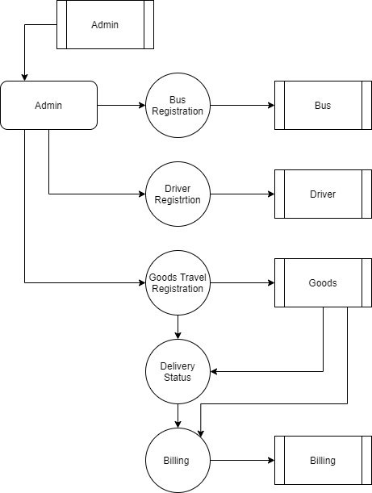
Level 1:

Slide 12
TABLE NAME: ADMIN
FIELD | DATA TYPE | SIZE | CONSTRAINT
admin id | Int | 10 | Primary key
Username | varchar | 20 | Not null
Password | varchar | 20 | Not null

Slide 13
TABLE NAME: vehicle
FIELD | DATA TYPE | SIZE | CONSTRAINT
Vehicle id | Int | 10 | Primary key
Vehicle name | Varchar | 20 | Not null
Vehicle type | varchar | 10 | Not null

Slide 14
TABLE NAME: DRIVER
FIELD | DATA TYPE | SIZE | CONSTRAINT
Driver id | Int | 10 | Primary key
Driver name | Varchar | 20 | Not null
Mobile number | Int | 10 | Not null
Address | varchar | 30 | Not null
License number | varchar | 10 | Not null
Age | Int | 3 | Not null
Id proof | varchar | 10 | Not null

Slide 15
TABLE NAME: GOODS
FIELD | DATA TYPE | SIZE | CONSTRAINT
Goods id | Int | 10 | Primary key
Vehicle id | Int | 10 | Foreign key
Driver id | Int | 10 | Foreign key
From | varchar | 20 | Not null
To | varchar | 20 | Not null
Goods name | varchar | 20 | Not null

Slide 16
TABLE NAME: BILLING
FIELD | DATA TYPE | SIZE | CONSTRAINT
billing id | Int | 10 | Primary key
Driver id | Int | 10 | Foreign key
Vehicle id | Int | 10 | Foreign key
Goods id | Int | 10 | Foreign key
Total amount | Int | 5 | Not null
Date | Date | 10 | Not null

Slide 17
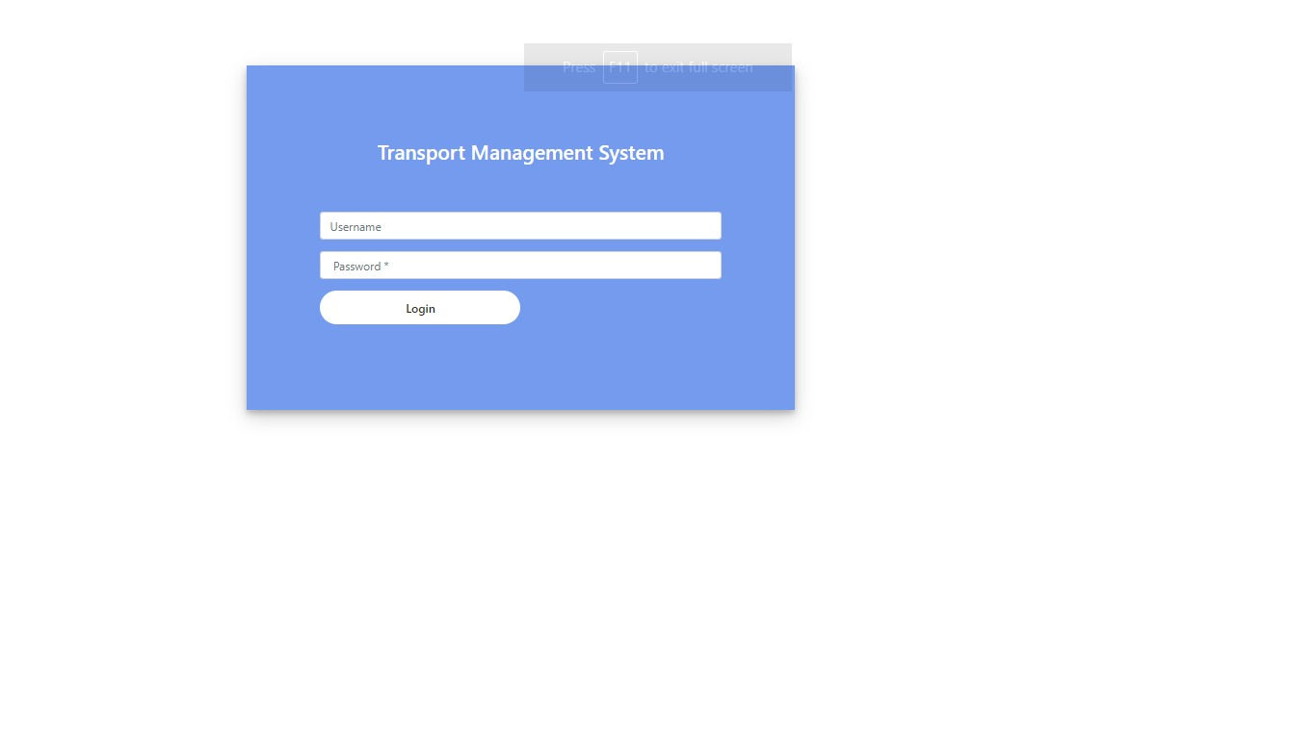

Slide 18
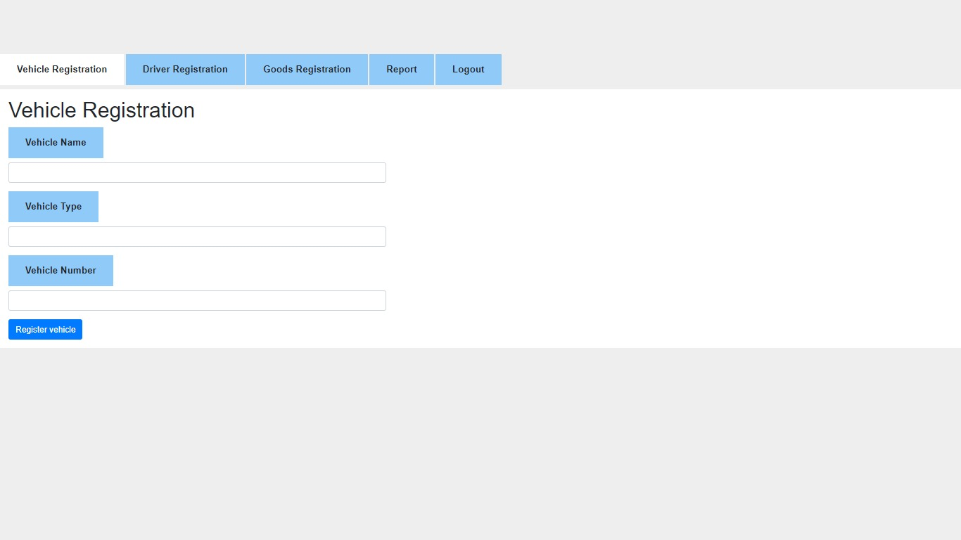

Slide 19
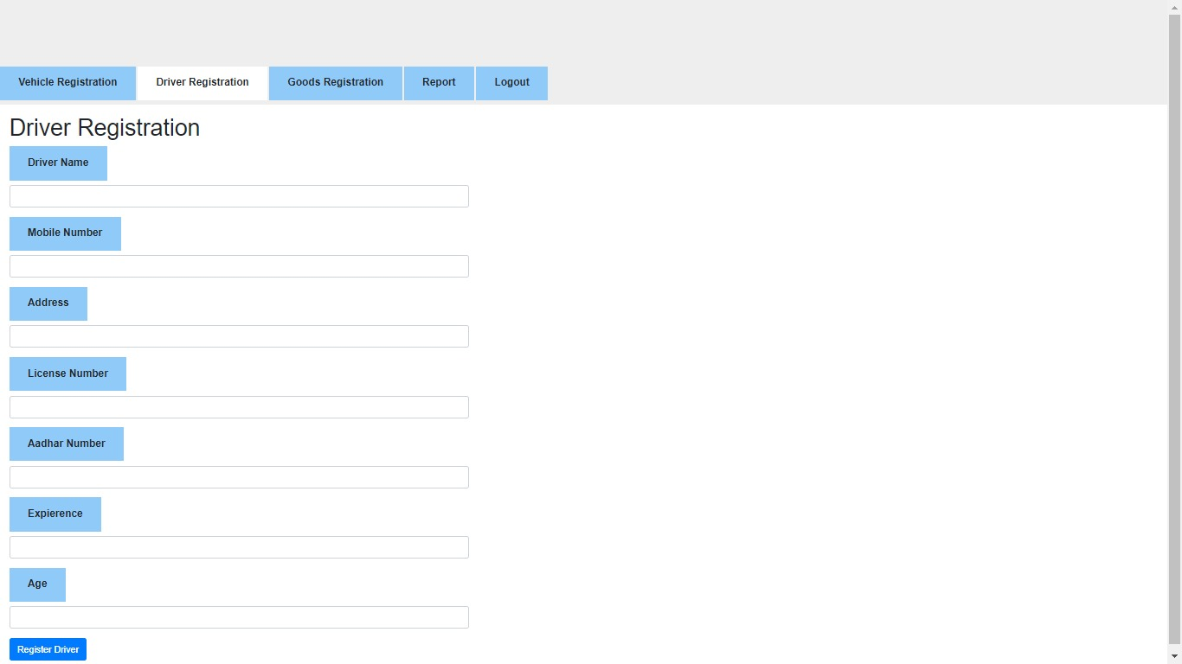

Slide 20
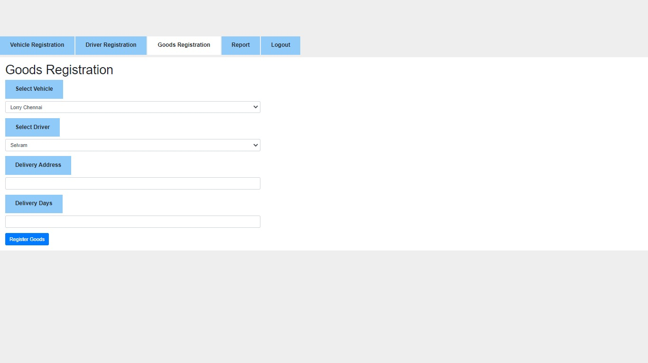

Slide 21
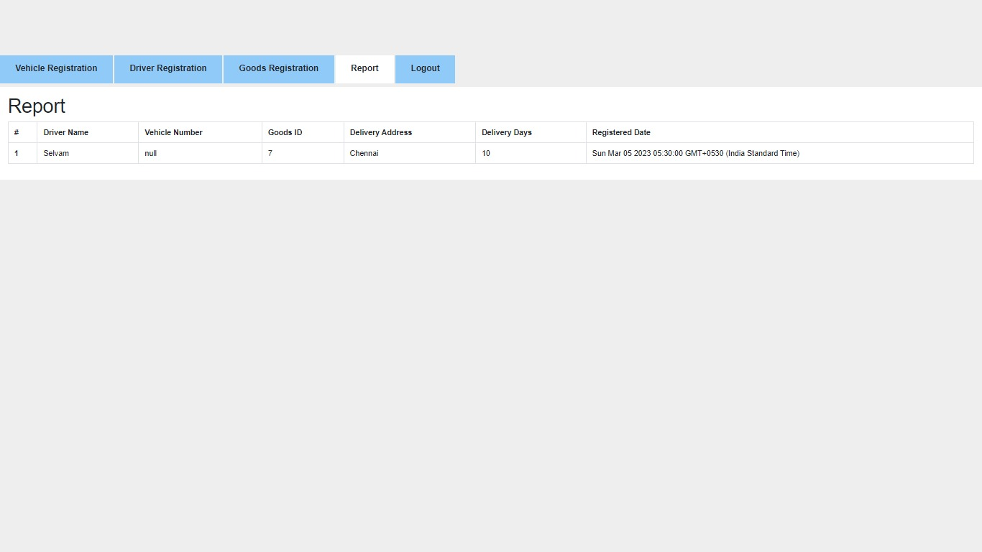

Slide 22
Thank You

